Slide 1
Digital Portfolio
STUDENT NAME: Abi C
REGISTER NO AND NMID: E4525ACFE600101AB224711903484A62 /astvu21021024u18048
DEPARTMENT: Bsc computer science.
COLLEGE: Sri Akilandeswari Womens college-Wandiwash.

Slide 2
PROJECT TITLE
Student Digital Portfolio using HTML , CSS, Java Script.

Slide 3


AGENDA
Problem Statement
Project Overview
End Users
Tools and Technologies
Portfolio design and Layout
Features and Functionality
Results and Screenshots
Conclusion
Github Link
3/21/2024 Annual Review

Slide 4

PROBLEM STATEMENT
Many beginners in web development find it hard to present their skills effectively.A portfolio website helps to display personal details, skills, and achievements clearly.It provides a platform to showcase completed projects in an organized manner.Without a portfolio, reaching potential employers or collaborators becomes difficult.Hence, a personal portfolio website is needed to highlight my work and contact details.

Slide 5

PROJECT OVERVIEW
This project is a personal portfolio website designed to showcase my skills and projects.It includes sections like About Me, My Projects, and Contact Me.The website is built using HTML, CSS, and JavaScript for a clean and responsive design.It highlights projects such as a Student Management System and a Mini Calculator.The portfolio serves as a professional platform to connect with potential employers.

Slide 6

WHO ARE THE END USERS?
The end users of this portfolio website are employers, recruiters, teachers, and friends.
They can view my skills, projects, and contact details easily.
It is mainly useful for those who want to know about my work.

Slide 7

TOOLS AND TECHNIQUES
This project is developed using HTML for structure.
CSS is used to style and design the layout.
JavaScript adds interactivity and functionality.
A simple text editor like VS Code is used for coding.
The website is tested using a web browser such as Chrome.

Slide 8
POTFOLIO DESIGN AND LAYOUT
This project is developed using HTML for structure.CSS is used to style and design the layout.
JavaScript adds interactivity and functionality.
A simple text editor like VS Code is used for coding.
The website is tested using a web browser such as Chrome.
8

Slide 9
FEATURES AND FUNCTIONALITY
The portfolio displays personal details, skills, and achievements.
It showcases projects with short descriptions for easy understanding.
A contact section allows users to reach me directly.
The design is responsive and works on different devices.
Navigation is simple, making it easy for users to explore sections.

Slide 10
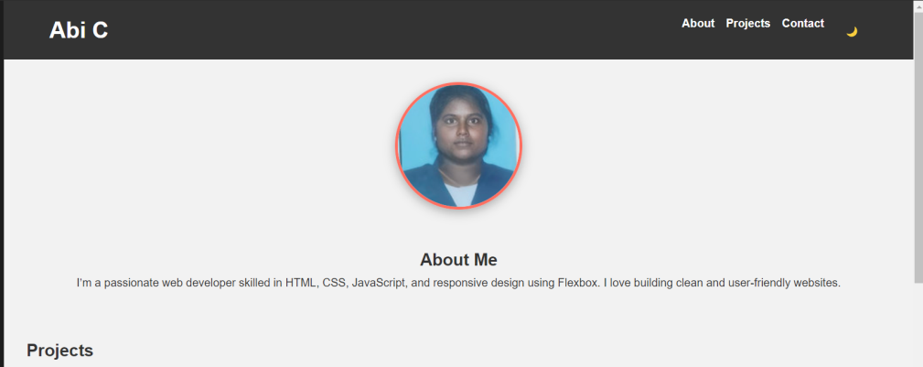
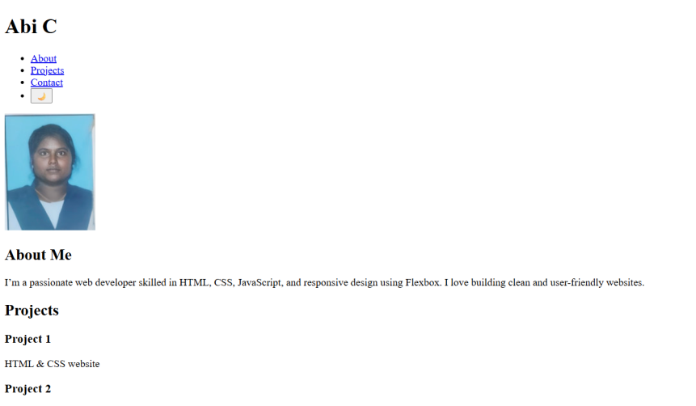
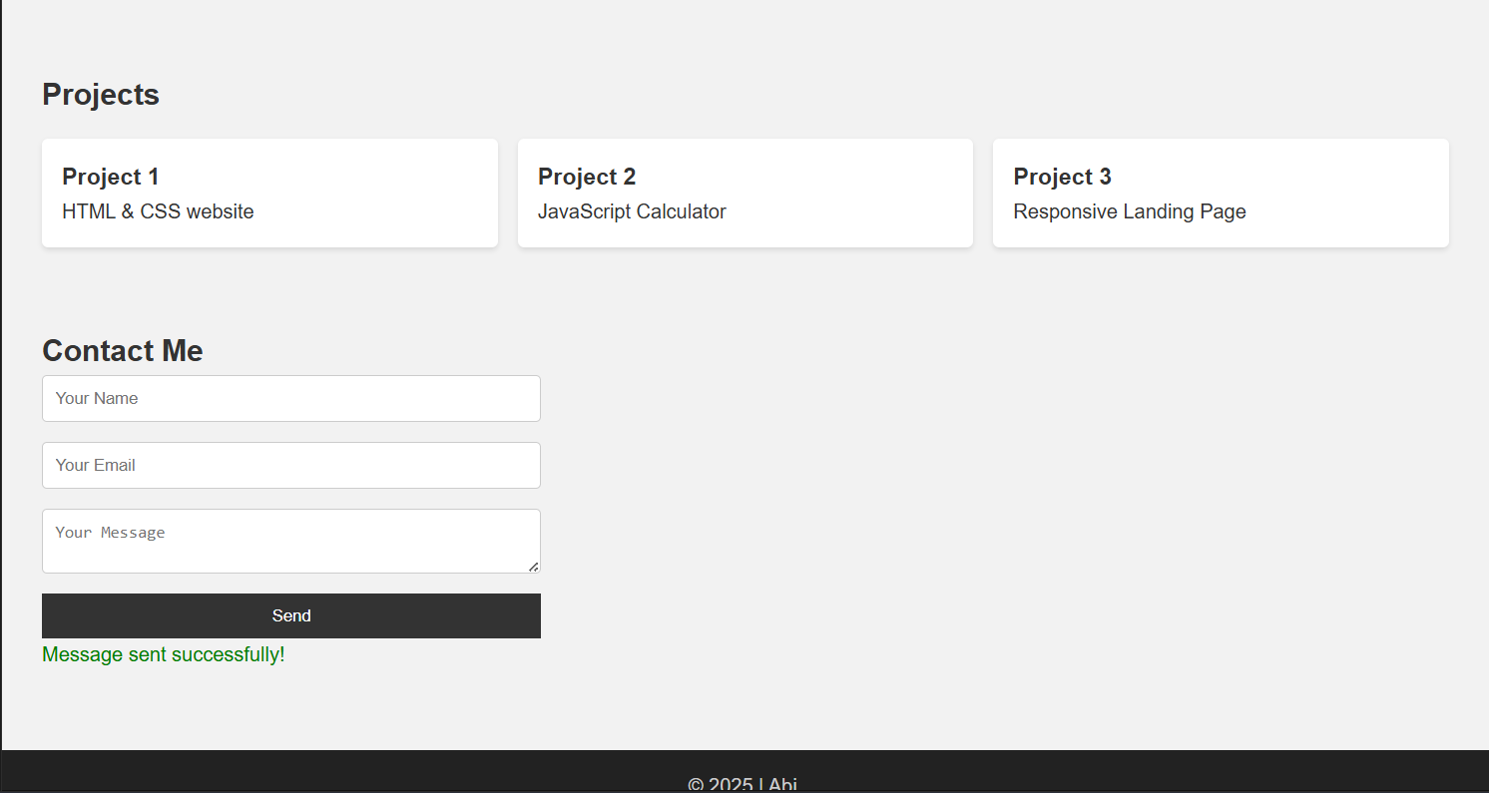

RESULTS AND SCREENSHOTS
1) Screenshots of each section.
2) Before vs After (plain HTML--> with CSS & JS).
3/21/2024 Annual Review
10

Slide 11
CONCLUSION
The portfolio website successfully presents my skills and projects.
It provides an easy way for employers and others to know about my work.
The clean design and simple layout make it user-friendly.
.It highlights my achievements and serves as my professional identity online.
Overall, it is a useful platform to connect with opportunities.
11

Slide 12
Git Hub link:
https://github.com/manisha7901258-debug/TNSDC-FWD-Digital-portfolio.git

